Slide 1
TopGen
Advance Analytic Solution
Marketing

Slide 2
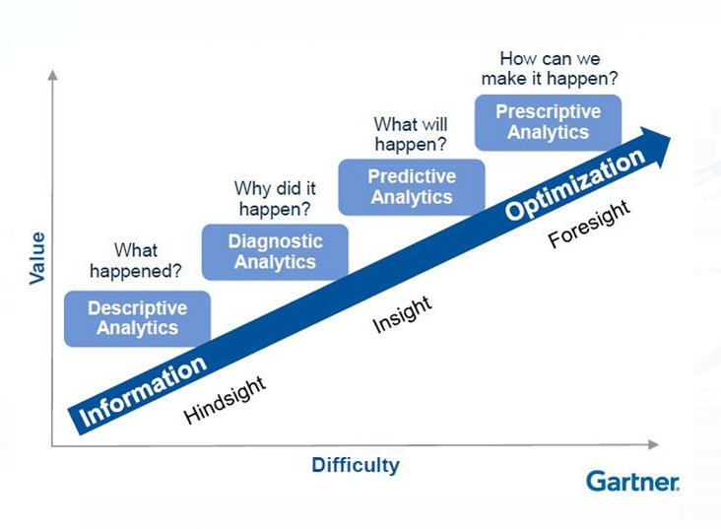
Level of Information Usage

Slide 3
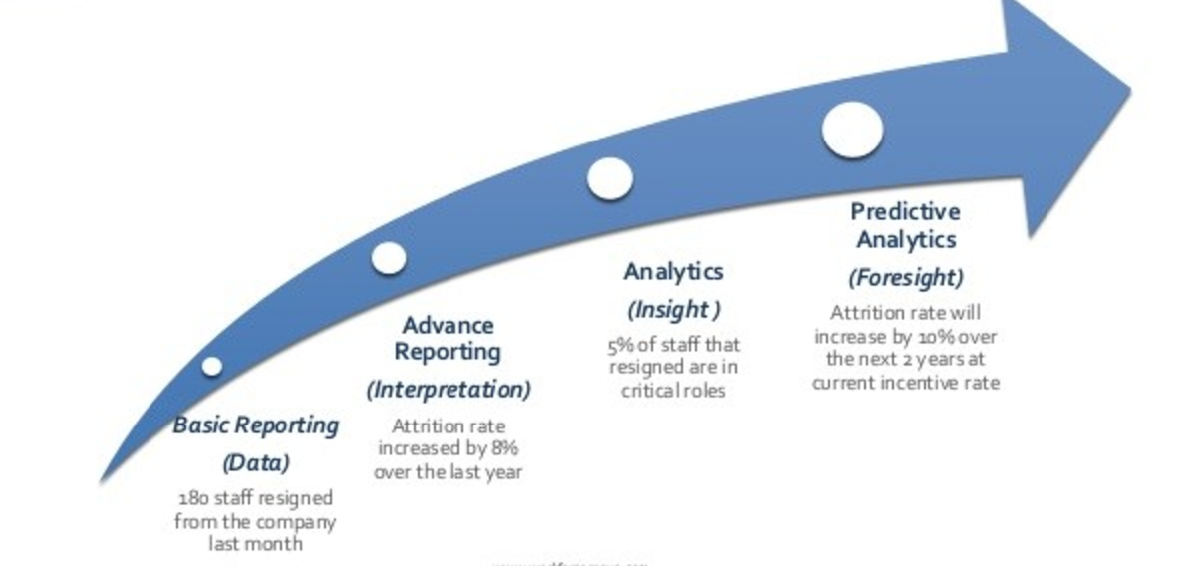
BI Analytic Maturity Model

Slide 4
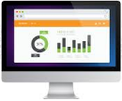







High-Level Solution Design Concept
Visualization Layer
Desktop Visualization
Mobile Visualization
Actionable Layer
Email Marketing
SMS
Social Media Marketing
Data Analytic Layer
BI Components
Adv. Analytic Components
Data Processing Layer
BRP Partner’s Database
ERP Database
WMS Database
Future databases …
Data Ingestion Layer
Customer Data
Landing Folder

Slide 5
Advance Analytic Solution – 1st Package
Understand Your
ENTIRE Customer Base
vs
ALL Product Categories
In-Combination

Slide 6








Example of Customer vs Product Categories
PRINTER
OTHERS
1-2 year
INK & TONER
1-3month
TECHNOLOGY
STATIONERY
3-6month
1-3month
OFFICE EQUIPMENT
1 month
CLEANING & BREAKROOM
6-9month

Slide 7
Questions to ASK
Knowing how many customer buying category Printer or Ink from your business start until today?
Who are they !?
How about question like:
  Do you know how many customers have purchased PRINTER + INK from you ?
  Who are they?
Question keep a little bit in-depth:
  How about the number of customer who has purchased PRINTER + INK + PAPER ?
  Who are they?
How about other customer purchasing pattern?
  Let say PRINTER + INK + STATIONARY?
  INK + STATIONARY?
  TECHNOLOGY + STATIONARY?
  …

Slide 8
Advance Processing
9 Categories create 511 patterns of segmentation.
10 Categories create 1023 patterns of segmentation.
11 Categories create 2047 patterns of segmentation.
12 Categories create 4095 patterns of segmentation.
13 Categories create 8191 patterns of segmentation.
14 Categories create 16383 patterns of segmentation.
15 Categories create 32767 patterns of segmentation.
What is the top 10 patterns that contain most of the customers?
Who are they!?
Benefits
  CROSS-SELL
  If PRINTER + INK + PAPER and PRINTER + INK + STATIONARY are 2 categories discovered as your TOP 10 pattern segmentation, THEN
    Customer who buy PRINTER, got high potential to buy INK or PAPER
    Customer who has already bought PRINTER + INK, but NOT YET buy PAPER and STATIONARY, those set of customers are having high chance to cross to buy STATIONARY and PAPER.
Target Marketing to specific segment for CROSS-SELL purpose.
Target Promotion to specific segment to close ALL CATEGORIES.

Slide 9
Advance Analytic Solution – 1st Package
What 1st package produce?
  Every customer emails, firstname, lastname, telephone, address, by each pattern of categories.
  Weekly tracking of Customer Movement between all pattern of categories.
  Information of who is NEW, REMAIN, MOVE-IN and MOVE-OUT from the patterns.
Benefit:
  Knowing your marketing strategy weekly.
  Monitor your crossing status, rate and marketing efficiency.
  Able to plan customer acquisition to specific pattern
  …

Slide 10
Advance Analytic Solution – 2nd Package
Customer
Purchasing Behavior
Analysis

Slide 11
Customer Purchasing Behavior Analysis
Why needed?
What is the benefit to business to have this ?

Slide 12
Advance Analytic Solution – 2nd Package
What will deliver…
Customer Purchasing Behavior Analysis
  Report of every specific customer
    Average spending power based on historical data
    Average buying product quantity
    Average order placed by Month, Quarter, Year
    Current, Target and Potential spending power on Target year.
    Potential buying categories…
  Report analysis include :
    By Overall Product Categories
    By Each Specific Product Categories
  Report of Missing, Returning, New Customer
  Report of customer spending power according to 5 categories: Low, Medium, Average, Good, Very High

Slide 13
Customer Purchasing Behavior Analysis
How marketing team will benefit from the deliveries?
What action can be perform to be more effectively?
How to proof / monitor ?

Slide 14
Advance Analytic Solution – 3rd Package
Market Basket Analysis
ORDER specific
ORDERLESS

Slide 15
Market Basket Analysis
Why needed?
What is the benefit to business to have this ?
Market Basket Analysis
  By Customer Purchasing Behavior
  By Historical Order Specific Behavior
  List of potential buying categories in-combination of 2, 3, and n categories.

Slide 16
Market Basket Analysis
What will deliver…
Market Basket Analysis
  By Customer Purchasing Behavior
  By Historical Order Specific Behavior
  List of potential buying categories in-combination of 2, 3, and n categories.

Slide 17
Market Basket Analysis
How marketing team will benefit from the deliveries?
What action can be perform to be more effectively?
How to proof / monitor ?

Slide 18
Reports Listing for 1st Package …
1st Package – Customer-Product Segmentation Reports
  Weekly Top 10/20/30 number of customer in combination of product categories.
  Weekly total number of cross-sale for categories
  Weekly total number of unique customer increment
  Weekly newly added individual customers with respect to category
  Weekly newly added company customers with respect to category
  Monthly Top 10/20/30 number of customer in combination of product categories.
  Monthly total number of cross-sale for categories
  Monthly total number of unique customers increment
  Monthly newly added individual customers with respect to category
  Monthly newly added company customers with respect to category
  Quarterly Top 10/20/30 number of customer in combination of product categories.
  Quarterly total number of cross-sale for categories
  Quarterly total number of unique customer increment
  Quarterly newly added individual customers with respect to category
  Quarterly newly added company customers with respect to category

Slide 19
Reports Listing for 2nd Package …
2nd Package – Customer Behavior Analysis Reports
  [Pie / Num / Perc] Overall business total number of individual / company customer.
  [Pie / Num / Perc] By each specific category total number of individual / company customer.
  Overall business yearly of total number of new customer / missing customer / returning customer.
  Overall business monthly of total number of new customer / missing customer / returning customer.
  Overall business quarterly of total number of new customer / missing customer / returning customer.
  By each specific category yearly of total number of new customer / missing customer / returning customer.
  By each specific category monthly of total number of new customer / missing customer / returning customer.
  By each specific category quarterly of total number of new customer / missing customer / returning customer.
  Overall categories yearly top 100 ~ 500 Total spending amount of customer.
  Overall categories monthly top 100 ~ 500 Total spending amount of customer.
  Overall categories quarterly top 100 ~ 500 Total spending amount of customer.
  By each specific yearly top 100 ~ 500 Total spending amount of customer.
  By each specific monthly top 100 ~ 500 Total Spending Amount of customer.
  By each specific quarterly top 100 ~ 500 Total spending Amount of customer.
  Overall categories yearly top 100 ~ 500 Average Spending Amount of customer.
  Overall categories monthly top 100 ~ 500 Average Spending amount of customer.
  Overall categories quarterly top 100 ~ 500 Average Spending amount of customer.
  By each specific yearly top 100 ~ 500 Average Spending amount of customer.
  By each specific monthly top 100 ~ 500 Average Spending amount of customer.
  By each specific quarterly top 100 ~ 500 Average Spending amount of customer.
  Overall business on total number of customer of minimum purchasing cycle (in month) from 1 month to 12 months.
  Overall business on total number of customer of average purchasing cycle (in month) from 1 month to 12 months.
  Overall business on total number of customer of maximum purchasing cycle (in month) from 1 month to 12 months.
  By each specific category on total number of customer of minimum purchasing cycle (in month) from 1 month to 12 months.
  By each specific category on total number of customer of average purchasing cycle (in month) from 1 month to 12 months.
  By each specific category on total number of customer of maximum purchasing cycle (in month) from 1 month to 12 months.

Slide 20
Reports Listing for 2nd Package … Cont.
2nd Package – Customer Behavior Analysis Reports
  Yearly Overall business on Top 100 ~ 500 of customers of Current Spending Value
  Yearly Overall business on Top 100 ~ 500 of customers of Target Spending Value
  Yearly Overall business on Top 100 ~ 500 of customers of Potential Spending value
  Yearly by specific category on Top 100 ~ 500 of customers of Current Spending Value
  Yearly by specific category Top 100 ~ 500 of customers of Target Spending Value
  Yearly by specific category Top 100 ~ 500 of customers of Potential Spending value
  Weekly segment of customer spending power according to Low, Medium, Average, Good and Very High cluster
  Monthly segment of customer spending power according to Low, Medium, Average, Good and Very High cluster
  Quarterly segment of customer spending power according to Low, Medium, Average, Good and Very High cluster
  Yearly segment of customer spending power according to Low, Medium, Average, Good and Very High cluster
  Yearly overall business on Top 10 ~ 50 number of order placed / product quantity purchased.
  Yearly by specific category on Top 10 ~ 50 number of order placed / product quantity purchased.
  Quarterly overall business on Top 10 ~ 50 number of order placed / product quantity purchased.
  Quarterly by specific category on Top 10 ~ 50 number of order placed / product quantity purchased.
  Monthly overall business on Top 10 ~ 50 number of order placed / product quantity purchased.
  Monthly by specific category on Top 10 ~ 50 number of order placed / product quantity purchased.

Slide 21
Reports Listing for 3rd Package …
3rd Package – Market Basket Analysis Reports
  Monthly Relationship of specific product category vs all product categories
  Monthly Order specific relationship of combination of 2 product categories vs next product category for all product categories.
  Monthly Order-less relationship of combination of 2 product categories vs next product category for all product categories.
  Monthly Top 1/3/5 high score of chance of next purchased category after specific product category being purchased.
  Monthly Top 1/3/5 high score of chance of next purchased category after 2 specific product categories being purchased.
  Quarterly Relationship of specific product category vs all product categories
  Quarterly Order specific relationship of combination of 2 product categories vs next product category for all product categories.
  Quarterly Order-less relationship of combination of 2 product categories vs next product category for all product categories.
  Quarterly Top 1/3/5 high score of chance of next purchased category after specific product category being purchased.
  Quarterly Top 1/3/5 high score of chance of next purchased category after 2 specific product categories being purchased.
  Yearly Relationship of specific product category vs all product categories
  Yearly Order specific relationship of combination of 2 product categories vs next product category for all product categories.
  Yearly Order-less relationship of combination of 2 product categories vs next product category for all product categories.
  Yearly Top 1/3/5 high score of chance of next purchased category after specific product category being purchased.
  Yearly Top 1/3/5 high score of chance of next purchased category after 2 specific product categories being purchased.

Slide 22
Year :
2013
Apply
Select specific segment of pie / bar / location to refresh the data records in table below.
SQL to query
the data
Php Rest Method
Google Chart
component display
/ refreshed here
PIE / BAR / MAP
DB
Tables
DE normalized
Data
Google Table component that display the selected data in Google Chart
CSV / Excel file for outputting the records listed in Google Table
Export to Excel

